Slide 1
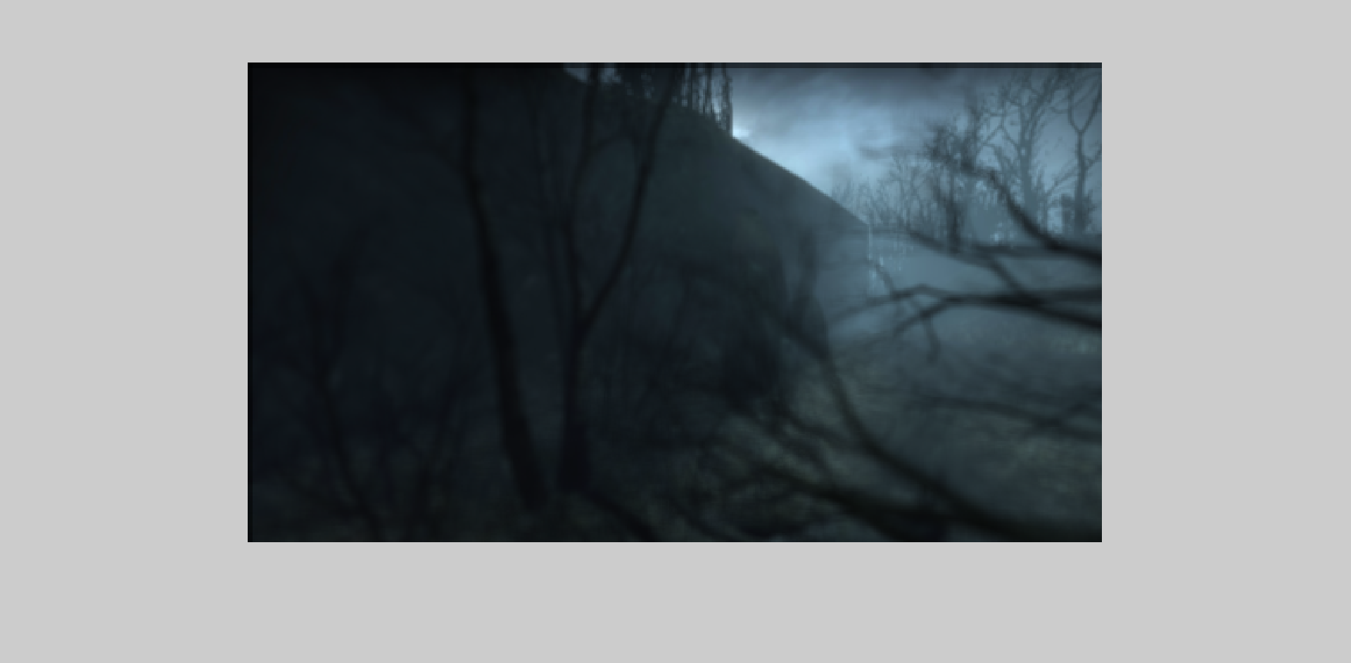
alpha = .3

Slide 2
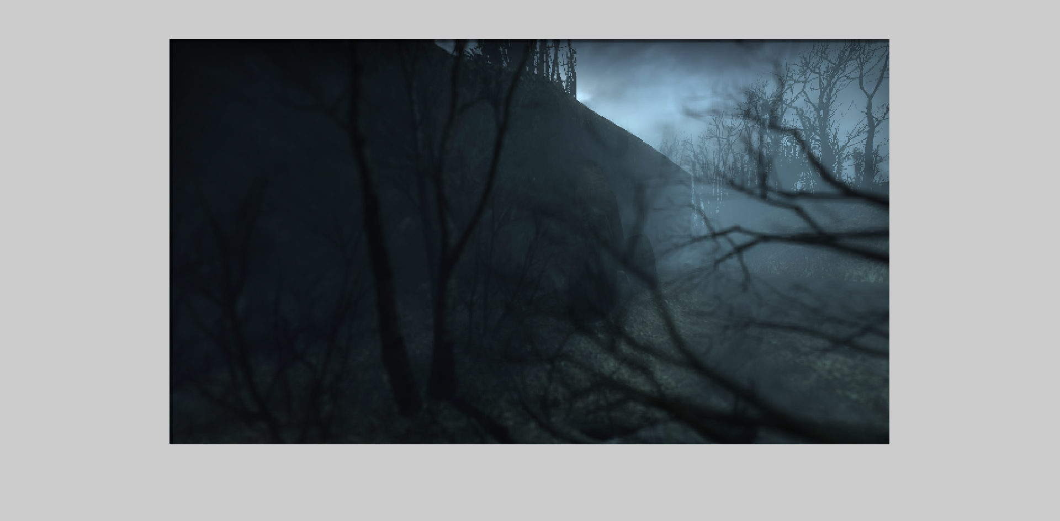
alpha = .4

Slide 3
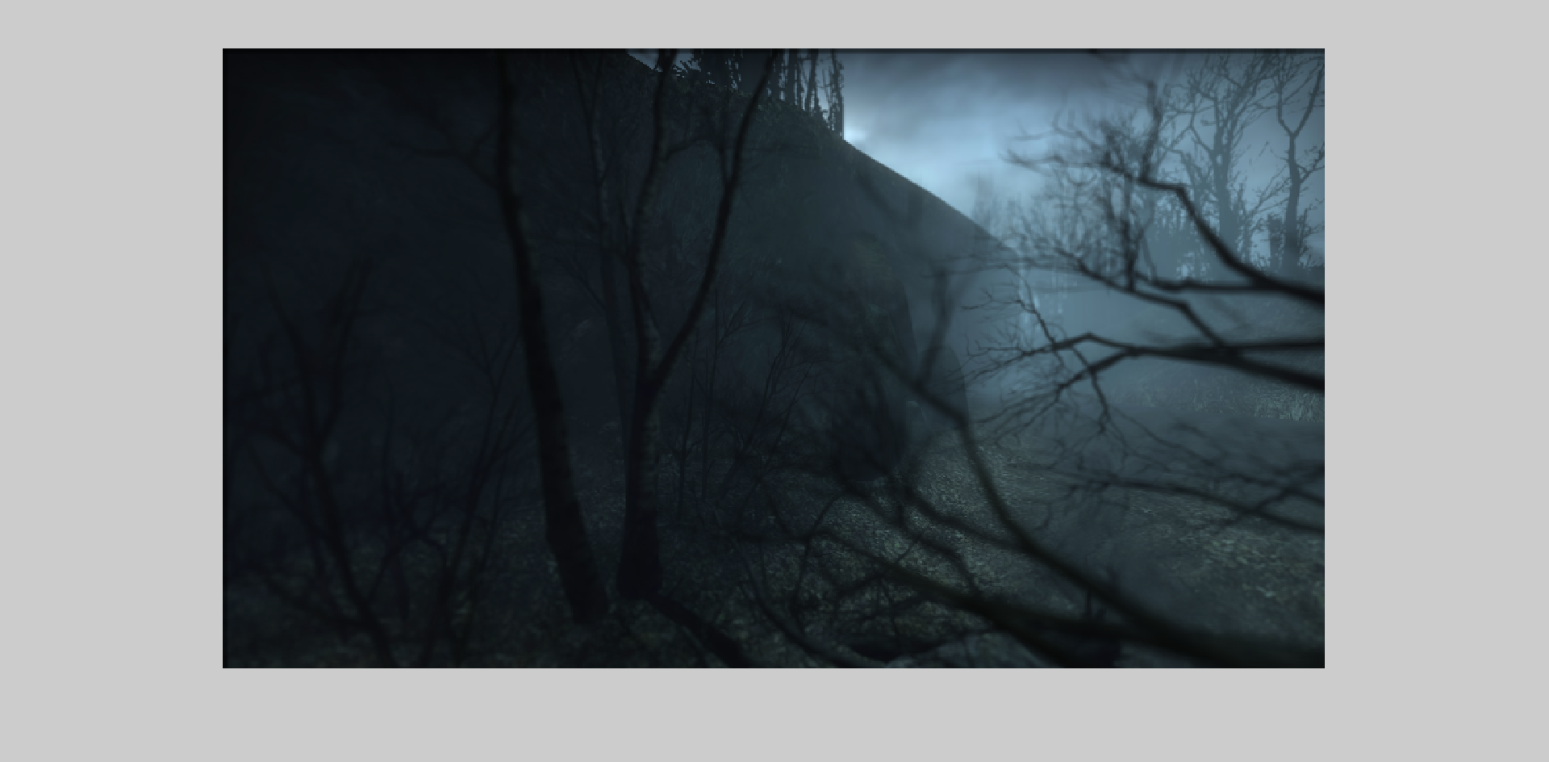
alpha = .5

Slide 4
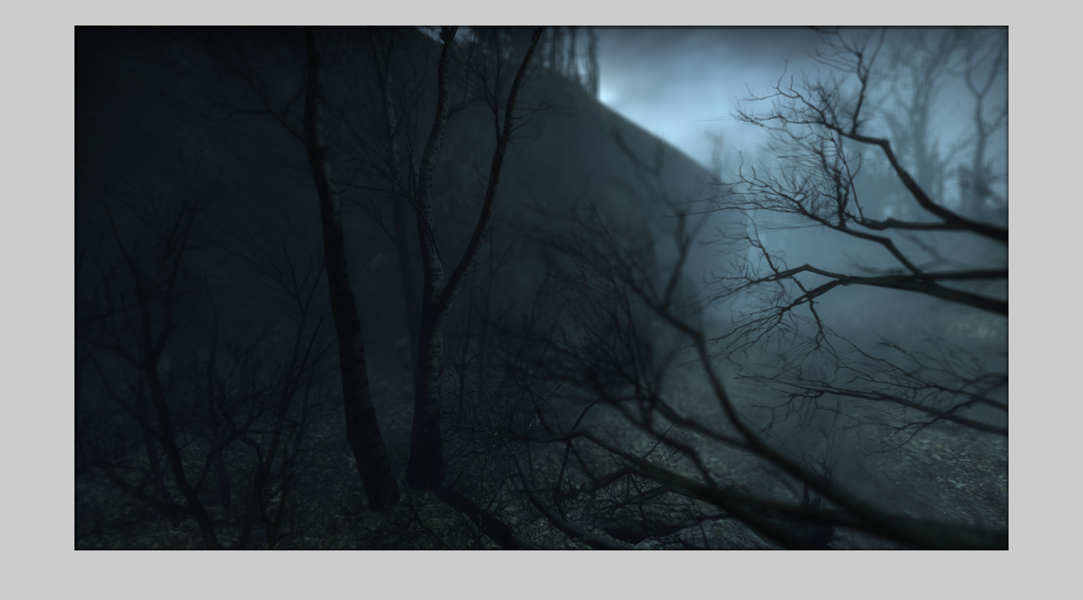
alpha = .8

Slide 5
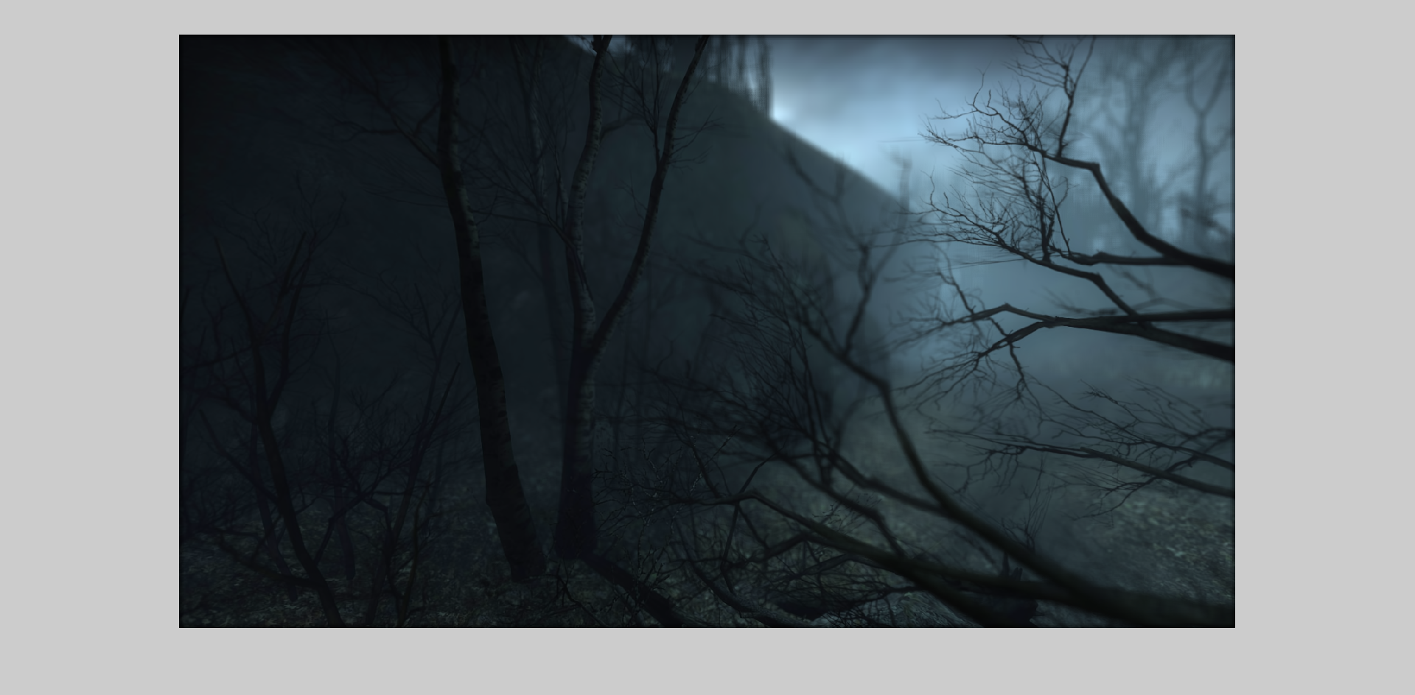
alpha = 1

Slide 6
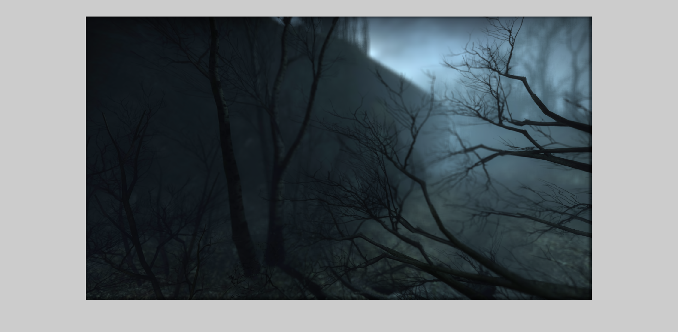
alpha = 2

Slide 7

alpha = 5

Slide 8

alpha = 10

